Slide 1

ENGINEERING DESIGN STORY
Design and Simulation of microprocessors using full adder
MAHITH - 2620040126
SAI CHARAN - 2620090144
YATHISH CHANDRA CHOWDARY - 2620040093 SRI RAM - 2620030507
From RISC-V architecture to a verified gate-level arithmetic circuit.
ARCHITECTURE
DATAPATH
ARITHMETIC
VERIFICATION

Slide 2
ONE PROJECT, SIX MODULES, ONE ARITHMETIC STORY
THE PROJECT ARC
Each module adds one layer of understanding until the full adder is explainable and testable.
M1 Computer architecture and the RISC-V ALU | M2 Datapath and control signals | M3 Storage, registers, and state
M4 Adders and two's-complement arithmetic | M5 Boolean algebra and logic-gate design | M6 Simulation, verification, and integration

Slide 3
THE CPU TURNS INSTRUCTIONS INTO DATA MOVEMENT
M1 · ARCHITECTURE
INSTRUCTION MEMORY
Instruction memory provides the operation. Registers provide operands. The ALU performs arithmetic or logic. Results return to registers or memory.
CONTROL UNIT
REGISTER FILE
ALU → DATA MEMORY → WRITE-BACK
INSTRUCTION → OPERANDS → OPERATION
→ RESULT

Slide 4
THE RISC-V ALU NEEDS ADDITION AT ITS CENTER
M1 · ALU CONTEXT
Integer instructions include add, subtract, and comparisons. The ALU receives operands A and B plus control signals.
Why start with a full adder? It is the one-bit building block behind wider addition.
RISC-V ISA reference: https://riscv.org/technical/specifications/
INPUTS A K B
ALU CORE
ARITHMETIC PATH
RESULT K FLAGS

Slide 5
DATAPATH: WHERE THE OPERANDS TRAVEL
M2 · DATAPATH
The datapath makes the arithmetic route visible.
REGISTER FILE
OPERAND BUSES
ALU
WRITE-BACK
A
B
RESULT
CARRY / OVERFLOW

Slide 6
CONTROL SIGNALS SELECT THE ARITHMETIC FUNCTION
M2 · CONTROL
One circuit supports multiple operations because control changes how the same adder path behaves.
OPERATION | ALUOP | BINVERT | CIN
ADD | add | 0 | 0
SUB | subtract | 1 | 1
LOGIC | logic select | function-dependent |  | 0
Subtraction reuses addition: complement B, then inject the initial carry.

Slide 7
REGISTERS HOLD VALUES BETWEEN CLOCK CYCLES
M3 · STATE
Combinational logic responds immediately to inputs. Registers capture results on a clock edge.
The ALU sits between stored values and the next state. State makes a processor sequence possible.
CURRENT STATE
ALU
CURRENT STATE → COMBINATIONAL LOGIC → NEXT STATE
NEXT STATE

Slide 8
CARRY IS DATA THAT MOVES THROUGH THE DATAPATH
M3 · CARRY PATH
Every bit produces a sum and a carry. That carry becomes part of the next bit's input.
STAGE 0
STAGE 1
STAGE 2
STAGE 3
Timing rule
The carry must settle before the output register captures the word.
Registers store the completed word, not each internal carry.

Slide 9
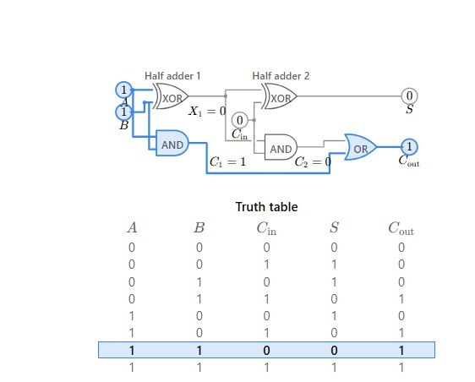
FROM HALF ADDER TO FULL ADDER
M4 · ARITHMETIC CIRCUITS
Adding A and B gives a half adder. Adding A, B, and carry-in gives a full adder with Sum and carry-out.
HALF-ADDER
FULL-ADDER
4-BIT ADDER
HALF ADDER: A + B
FULL ADDER: A + B + CIN
4 FULL ADDERS → 4-BIT ADDER

Slide 10
THE FULL-ADDER EQUATIONS ARE SIMPLE AND REUSABLE
M4 · REUSABLE LOGIC
SUM
Sum = A ⊕ B ⊕
Cin
Sum is 1 when an odd number of inputs are 1.
XOR detects odd parity.
CARRY-OUT
Cout = (A ∧
B) ∨ (Cin ∧ (A ⊕
B))
Cout is 1 when at least two inputs are 1.
AND finds pairs; OR combines the carry cases.
A | B | CIN | SUM | COUT
0 | 0 | 0 | 0 | 0
0 | 0 | 1 | 1 | 0
0 | 1 | 0 | 1 | 0
0 | 1 | 1 | 0 | 1
1 | 0 | 0 | 1 | 0
1 | 0 | 1 | 0 | 1
1 | 1 | 0 | 0 | 1
1 | 1 | 1 | 1 | 1
References: RISC-V specifications, https://riscv.org/technical/specifications/ · Logisim Evolution documentation, https://github.com/logisim-evolution/logisim-evolution
· M. Morris Mano, Digital Design · Thomas L. Floyd, Digital Fundamentals.

